Slide 1


Introduction to Smart Contract Development
By: Shivani thakur, Saurabh Mishra
Guide: dr. ankit gangwal

Slide 2
Smart Contracts

Slide 3
What are Smart Contracts?
Self-executing digital contracts with terms written in code
Eliminates intermediaries like banks & lawyers
Works on blockchain for transparency & security

Slide 4
History of Smart Contracts
1994: Concept introduced by Nick Szabo
2009: Bitcoin brought decentralized transactions but limited scripting
2015: Ethereum launched, enabling fully programmable smart contracts

Slide 5
Types of Smart Contracts
Smart contracts are categorized into three main types based on their function and use case:
1️⃣ Smart Legal Contracts – Legally enforceable agreements stored on the blockchain. They follow "If this happens, then that will happen" logic and ensure transparency & compliance. Example: Automatic payment execution upon deadline.
2️⃣ Decentralized Autonomous Organizations (DAOs) – Blockchain-based governance systems where decisions are made through voting rights encoded in smart contracts. No central authority; funds and operations are collectively managed. Example: VitaDAO (scientific research funding).
3️⃣ Application Logic Contracts (ALCs) – Smart contracts that handle interactions between applications and systems, such as IoT devices and blockchain networks. They automate machine-to-machine processes rather than human agreements.

Slide 6
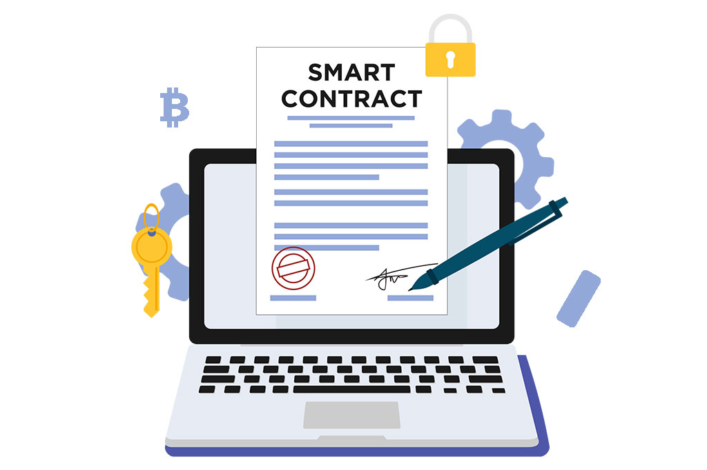
How Smart Contracts Work
Steps in Smart Contract Functioning:
1️⃣ Agreement – Parties define terms, conditions, and execution triggers. 2️⃣ Contract Creation – Code is written in a programming language and security-verified. 3️⃣ Deployment – The contract is uploaded and activated on the blockchain. 4️⃣ Monitoring Conditions – The contract tracks blockchain events or external triggers. 5️⃣ Execution – When conditions are met, the contract performs actions (e.g., payments, ownership transfer). 6️⃣ Recording – The transaction is verified and permanently stored on the blockchain for transparency.

Slide 7
How Smart Contracts Work
Written using Solidity
Deployed on Ethereum blockchain
Executes automatically when conditions are met
Example: Automated crowdfunding platform

Slide 8
Key Benefits of Smart Contracts
Automation: No human intervention
Transparency: Publicly verifiable transactions
Security: Immutable and tamper-proof
Cost savings: No intermediaries, reducing fees

Slide 9
Use Cases of Smart Contracts
DeFi (Decentralized Finance): Peer-to-peer lending & trading
NFTs (Non-Fungible Tokens): Digital art & collectibles
DAOs (Decentralized Governance): Community-driven organizations
Supply Chain: Transparent product tracking
Real Estate: Automated property transactions

Slide 10
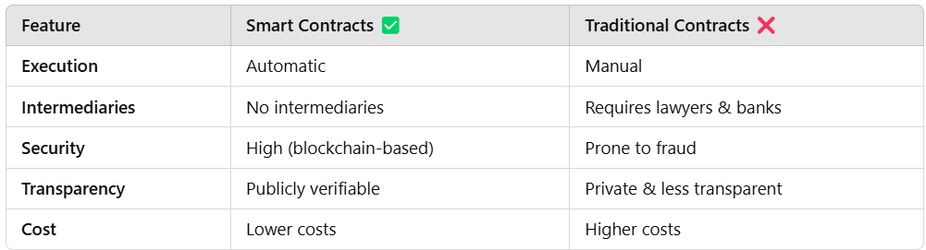
Comparison: Smart vs. Traditional Contracts

Slide 11
Ethereum Development & Tools

Slide 12
How Smart Contract Development Works
1️⃣ Writing Code in Solidity → Using Remix IDE or VS Code
2️⃣ Local Testing → Using Hardhat, Ganache, or Foundry
3️⃣ Deploying to a Testnet → Using MetaMask, Alchemy, or Infura
4️⃣ Final Debugging & Fixes → Simulating transactions
5️⃣ Deploying to Mainnet → Using real ETH

Slide 13

Ethereum Networks – Mainnet vs. Testnets
Mainnet (Live Network):
- Real Ethereum blockchain
- Transactions are permanent and involve real ETH
- Used for fully tested smart contracts
Testnets (Development Networks):
- Mimic Mainnet but use test ETH
- Safe environment for testing smart contracts
- Popular Testnets: Sepolia, Holesky, Goerli (Deprecated)

Slide 14
Local Testing – First Step in Development
Why Local Testing?
- Fast and efficient testing without network delays
- No gas fees involved
- More control over debugging
Tools for Local Testing:
- Hardhat (Ethereum development framework)
- Ganache (Local Ethereum blockchain simulator)
- Foundry (Fast Solidity testing tool)

Slide 15
MetaMask – Your Gateway to Ethereum
Browser extension & mobile wallet for Ethereum
Connects users to blockchain applications (dApps)
Supports multiple networks (Mainnet, Testnets, Custom Networks)
Stores ETH and tokens, sends/receives transactions
MetaMask is a non-custodial crypto wallet that allows users to store, manage, and interact with Ethereum-based assets, including cryptocurrencies and NFTs.
1. Install MetaMask (Browser extension or mobile app)
2. Create a wallet and store the 12-word seed phrase securely
3. Switch networks (e.g., Mainnet to Sepolia for testing)
4. Get test ETH from a faucet
5. Interact with smart contracts in dApps

Slide 16
Introduction to Remix IDE
Online development environment for Ethereum smart contracts
No installation required, beginner-friendly
Key Features:
🛠 Solidity Compiler – Converts Solidity code to bytecode
🐞 Debugger – Identifies contract errors
🖥 Built-in EVM – Simulates transactions
🚀 Direct Deployment – Deploy contracts to testnets/Mainnet

Slide 17

REMIX IDE Tour

Slide 18
Writing Your First Smart Contract

Slide 19

What is Solidity?
- High-level, object-oriented programming language
- Used for smart contracts on Ethereum & EVM-compatible blockchains
- Inspired by JavaScript, Python, and C++
- Enables trustless, automated contract execution

Slide 20
Example Solidity Contract
// SPDX-License-Identifier: MIT
pragma solidity ^0.8.0;
contract HelloWorld {
string public message = "Hello, Solidity!";
}

Slide 21
Structure of a Smart Contract
License & Version Declaration
Contract Definition
State Variables
Functions
Events & Modifiers

Slide 22
Variable Scope in Solidity
State Variables (Stored on blockchain)
Local Variables (Inside a function)
Global Variables (Blockchain info, e.g., msg.sender)

Slide 23
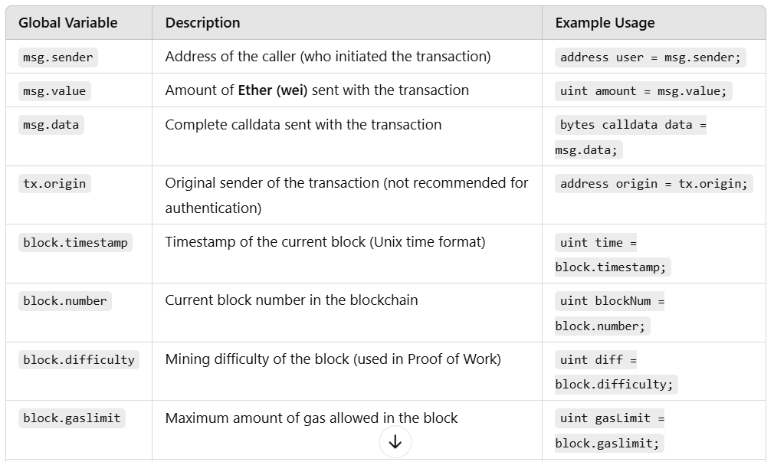
Global Variable

Slide 24
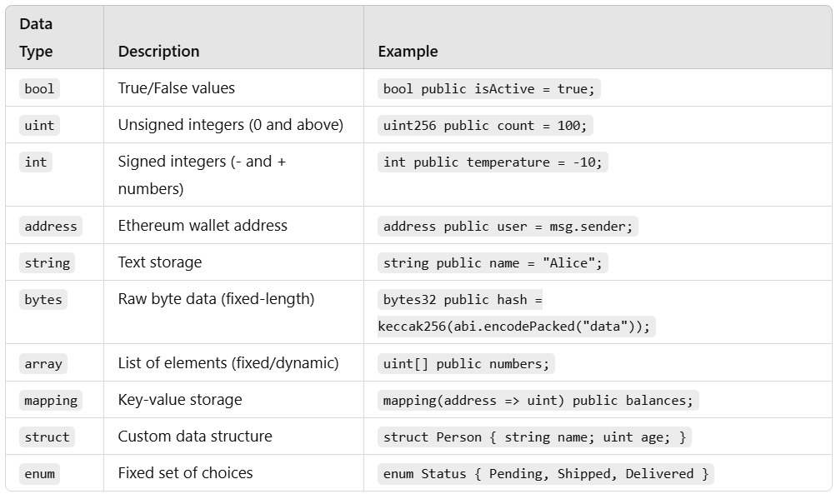
Solidity Data Types
Value Types → Store data directly in memory
Reference Types → Store references to data
(arrays, mappings, structs)

Slide 25
Operators & Control Structures
Arithmetic: +, -, *, /, %
Logical: &&, ||, !
Comparison: ==, !=, <, >
If-Else, Loops (for, while)

Slide 26
Example Function Code
function myFunction() public {
// Function logic
}
function functionName(parameterType parameterName) visibilityModifier stateMutabilityModifier returns (returnType) {
// Function logic
}

Slide 27
Functions in Solidity (Types)
Public: Accessible externally
Private: Internal use only
Internal
External

Slide 28
Functions in Solidity (Mutability)
View (Do not modify blockchain state (no gas fee if called externally).
Pure (Cannot read or modify blockchain state.)
Payable (Allows the function to receive Ether)

Slide 29
Function Modifiers
Restricts access or adds logic to functions
Example:
modifier onlyOwner() {
require(msg.sender == owner, "Not the owner!");
_;
}
function restrictedFunction() public onlyOwner { // Only the contract owner can call this }
function setAge(uint _age) public {
require(_age >= 18, "Must be at least 18");
age = _age;
}

Slide 30
Live Coding: Writing a ‘Voting’ Contract

Slide 31
Thank You!

